Slide 1

Computer Vision Case Study
Suggesting: Pose detection and estimation
$$\text{Abdul} \text{Rehman}$$
Contact email: abdulrehman786302@gmail.com

Slide 2

Abdul Rehman
Abdul Rehman earned a master's degree in multimedia networking from Telecom Paris Tech, France in 2020. He is now pursuing a doctorate in cyber security in multimedia at IMT Atlantique. The PhD is funded by IRT b<>com, a private research center in France.
His research focuses on the intersections of multimedia processing, AI, and deep learning.

Slide 3
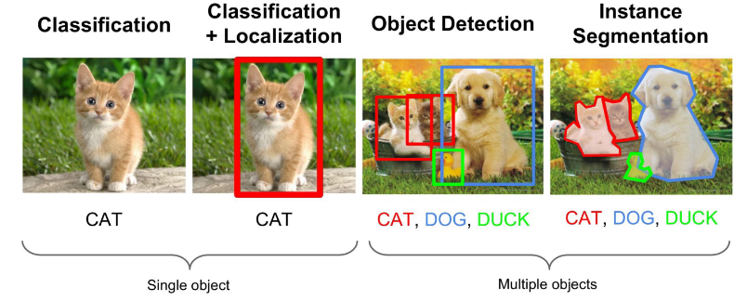
Generic Setup Analysis
Ideal Computer Vision Techniques:
Classification
Object detection
Segmentation
Hardware Setup:
RBG 2D or 3D camera
ROS
Robot and tools bank
Operating system for vision
Camera
Object Detection
Position or pose
Order & Number
Operations
Remove
Components

Slide 4
1.1 Comparison Vision Techniques:
Industry Deep Learning Advantages:
360p cameras (UAVs, UGVs)
Spherical image complicates tradition CV methods.
3D Vision (Classification, Geometry and Graphics)
Lots of development with 3D neural networks:
Computational complexity increases
3D traditional CV even more difficult:
Extra dimensions increase uncertainty (e.g., occlusions, camera angles, etc.).
Traditional | Deep Learning
HOG(Histogram Oriented Gradient), SURF (Speeded Up Robust Features ), Edge Detection and Motion Estimation | CNN Segmentation networks YOLO(You Only Look Once)
Differences | Deep Learning | Traditional
Manual feature extraction | No | Yes
Computationally-heavy | Yes | No
Huge label dataset | Yes | No
Easy to deploy | No | Yes
Accuracy | Yes | No
Notes:
-heavy barrel distortion due to the ultra-wide-angle fisheye lens
-lane detection and trajectory tracking.
-pre-processing steps such as prior calibration and deworming are often required.
Occlusion often occurs when two or more objects come too close and seemingly merge or combine with each other.

Slide 5
1.2 Detection with Deep learning
CNN(Convolutional Neural Network):
CNN are made up from neurons.
Each neuron has a specific weight and bias.
CNN-architecture contains several layers.
Primarily an input layer, an ouput layer, and hidden layers.
A convolutional layer, a pooling layer, and other normalization layers make up the hidden layer.
A convolution method is performed by the convolutional layer.
Convolution in object detection is a method used to generate an output function from a filter.
The pooling layer reduce the dimension of the input.
Region-Based Methods | Classification-Based Methods
R-CNN, Faster R-CNN | YOLO, SSD(Single Shot Detector)
Notes:
(R-CNN), combines rectangular region proposals with convolutional neural network features.
R-CNN is a two-stage detection algorithm.
The first stage identifies a subset of regions in an image that might contain an object.
The second stage classifies the object in each region.
Applications for R-CNN object detectors include:
Autonomous driving
Smart surveillance systems
Facial recognition

Slide 6
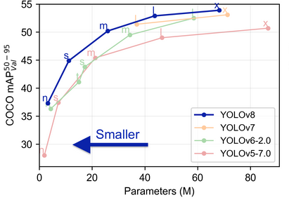
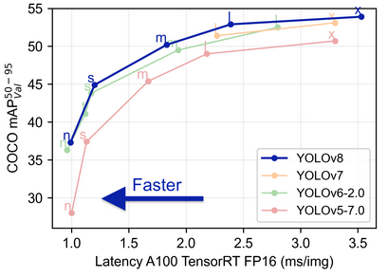
1.3 YOLO(You Only Look Once):
YOLO(You Only Look Once):
One of the well known object detection algorithms
Speed and accurate
Version of YOLO:
Version | Author | Release Date
V1 | Joseph Redmon | Jun 2015
V2 | Joseph Redmon and Ali Farhadi | Dec 2016
V3 | Joseph Redmon and Ali Farhadi | Apr 2018
V4 | Alexey Bochoknovskity | Apr 2020
V5 | Glenn Jocher | May 2020
V6 | Li et al. | Jun 2022
V7 | WongKinYiu and (AlexeyAB) | Jul 2022
V8 | Joseph et al. | Jan 2023
V8 is fastest.
V8 is light weight
References
Lin, TY. et al. (2014). Microsoft COCO: Common Objects in Context. In: Fleet, D., Pajdla, T., Schiele, B., Tuytelaars, T. (eds) Computer Vision – ECCV 2014. ECCV 2014. Lecture Notes in Computer Science, vol 8693. Springer, Cham. https://doi.org/10.1007/978-3-319-10602-1_48.
[74] YoloV5 Ultralytics. Tips for Best Training Reults. url: https://github.com/ultralytics/yolov5/wiki/Tips-for-Best-Training-Results. (accessed: 03.05.2024).
Notes:
COCO is a large-scale object detection, segmentation, and captioning dataset. COCO has several features:
Object segmentation
Recognition in context
Superpixel stuff segmentation
330K images (>200K labeled)
1.5 million object instances
80 object categories
91 stuff categories
5 captions per image
250,000 people with keypoints
Adaptive Training Sample Selection (ATSS) deep learning method applied to close-range and low-cost terrestrial RGB images.
The main advantage of the ATSS method is that only the center point of the objects is labeled, which is much more practicable and realistic than bounding-box annotations in heavily dense fruit orchards.
Adaptively Spatial Feature Fusion (ASFF) is proposed to learn the way to spatially filter conflictive information to suppress the inconsistency, thus improving the scale-invariance of features, and introduces nearly free inference overhead.

Slide 7
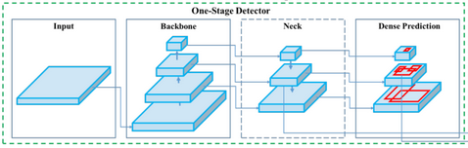
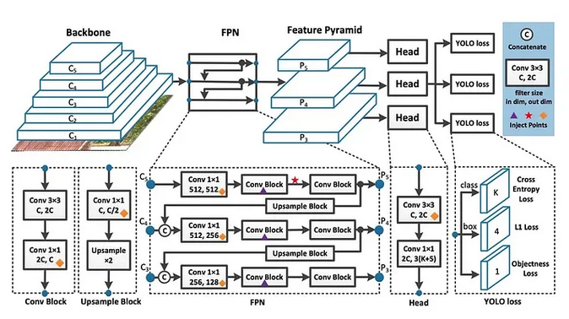
1.4 YOLO v8
The architecture consists of a backbone, neck, and head.
The backbone, is a pre-trained Convolutional Neural Network (CNN):
that extracts low, medium, and high-level feature maps from an input image.
The neck, merges feature maps using path aggregation blocks like the Feature Pyramid Network (FPN).
The head, classifying objects and predicting bounding boxes.
Anchor Free Detection:
YOLOv8 is an anchor-free model. This means it predicts directly the center of an object instead of the offset from a known anchor box.
Notes:
One of the standout features of YOLOv8 is its ability to simultaneously detect objects at multiple scales within the same image. Objects can vary significantly in size, from tiny details to large structures, and YOLOv8’s adaptability ensures that it identifies objects with precision across this wide spectrum. This capability enhances its utility across diverse applications, from spotting small items in medical images to recognizing vehicles in satellite imagery.

Slide 8
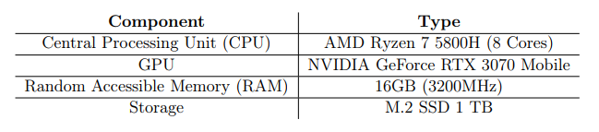
2 Sensor Integration:
Zivid One+:
A RGB-D camera which combines 2D images with the 3D technology, structured light.
1920 x 1200 resolution, i.e. 2.3Mpixel
Induction sensor:
Information about electrical conductivity
Electromagnetic field changes and signal fluctuations are measurable
Computer Hardware:
Notes:
Based on a generated electromagnetic field, that changes when an electrically conductive object approaches it. The resulting field changes and signal fluctuations are measurable.

Slide 9
2.1 Deployment:
ROS:
ROS is a meta-operating system for robots.
Number of independent nodes, each of which communicates with the other nodes using a publish/subscribe messaging model.
Realtime implementation:
Edge computing
Cloud computing
 | Edge Computing | Cloud Computing
Data Processing | Distributed among local devices and gateways | Centralized in remote data center
Costs | Less scalable expensive | Higher Scalability Lower operating costs
Latency | Lower latency | higher latency
Notes:
NVIDIA Isaac ROS
In this section, we show the steps to take the trained and optimized model and deploy it using NVIDIA Isaac ROS on iRobot’s Create 3 robot powered by Jetson Xavier NX. Both Create 3 and the NVIDIA Isaac ROS image segmentation node run on ROS2.
Data Processing: Centralized vs Distributed
One of the main differences between cloud and edge computing is how data is processed.
In cloud computing, processing is centralized in remote data centers: in practice, cloud computing moves data processing and IT resource management from local devices to remote data centers, enabling greater scalability, flexibility, and cost reduction.
In edge computing it is distributed among local devices and gateways. This difference has a significant impact on aspects such as latency, bandwidth, and security.
Scalability and Costs
Cloud Computing offers nearly unlimited scalability, allowing IT resources to be expanded or scaled down according to needs. Thanks to the pay-as-you-go model, businesses only pay for the resources they actually use, reducing operating and maintenance costs. Additionally, the cloud service provider takes care of updating and maintaining the infrastructure, freeing businesses from this task.
Edge Computing may be less scalable than Cloud Computing because processing and storage resources are limited to devices and local gateways. Edge infrastructure management and maintenance can be more complex and expensive than Cloud Computing because they require direct intervention on devices and gateways.
Latency and Bandwidth
In cloud computing, data must be transmitted to and from remote data centers, which can cause higher latency and bandwidth consumption. This can be problematic for real-time applications or those requiring rapid data processing, such as virtual and augmented reality, industrial automation, and autonomous vehicles.
Edge computing, on the other hand, processes data directly at or near the source, significantly reducing latency and bandwidth consumption. This makes it ideal for real-time applications and environments with limited or costly connectivity.

Slide 10
2.2 Continuous Improvement
Generative AI and Synthetic Data
Current Challenges with Real Data
Companies often struggle to implement AI due to data-related challenges.
data regulations,
sensitivity, financial
financial Implications
Area | Application of Generative AI | Benefits
Machine Learning | Enhancing datasets in limited or non-diverse scenarios. | Improves training of machine learning models by introducing diverse data points.
 | Augmenting training datasets for model robustness. | Enhances model performance, especially in data-restricted situations.
Testing | Testing data-centric applications (data pipelines, algorithms, software). | Validates the performance and resilience of various system components.
 | Creating specific test cases and scenarios. | Assists in assessing system performance and resilience in edge cases and outliers
Data Augmentation | Expanding training datasets in fields like computer vision. | Increases dataset size and diversity, aiding in model training.
 | Generating additional data points. | Reduces overfitting, and enhances performance on new data
GAN’s
VAE’s
GANs, a neural network that includes both a "generator" and a "discriminator."
Generator produces synthetic data that closely resembles real data,
Discriminator effectively differentiates between genuine and synthetic data.
AI Models
VAEs use an "encoder" and a "decoder" to generate synthetic data.
Encoder summarizes the characteristics and patterns of real-world data.
Decoder tries to convert that summary into a synthetic dataset that is very similar to real data.
Notes:
1. Data Regulations
Data regulations are in place to safeguard individual privacy, but they can limit the types and amounts of data available for developing AI systems.
2. Sensitive Data
Since many AI applications involve sensitive customer data, protecting privacy becomes crucial, which requires careful anonymization, a complex and costly process.
3. Financial Implications
Violating regulations can have severe financial consequences, further complicating matters.
4. Data Availability
The difficulty hinders the advancement in crafting potent AI models in obtaining significant quantities of high-quality historical data for training. This creates a challenge that can be overcome using Synthetic Data.
This is where synthetic data comes into play, offering a valuable solution.
Synthetic data is a tool that can be utilized to create complex and varied datasets that are like real-world data but without any personal information, which reduces the risk of violating compliance regulations. Moreover, synthetic data can be produced whenever required, addressing the problem of data scarcity and enabling more effective AI model training.
GANs, conversely, are a type of neural network that includes both a "generator" and a "discriminator." The generator produces synthetic data that closely resembles real data, while the discriminator effectively differentiates between genuine and synthetic data. Synthetic data provides a secure avenue for researchers and organizations to share datasets without compromising the privacy of personally identifiable information (PII). In the training process, the generator and discriminator compete to produce synthetic data that convincingly mimics real data, fooling even the most sophisticated models. Over time, this process creates a high-quality synthetic dataset that closely resembles real data.
3. Finally, VAEs use an "encoder" and a "decoder" to generate synthetic data. The encoder summarizes the characteristics and patterns of real-world data, while the decoder tries to convert that summary into a synthetic dataset that is very similar to real data. VAEs can generate fictitious rows of tabular data that follow the same rules as real data.

Slide 11
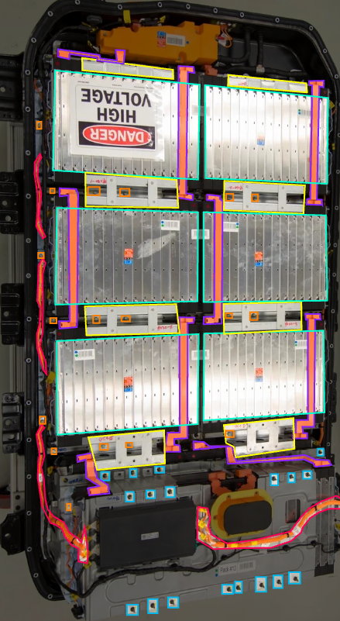
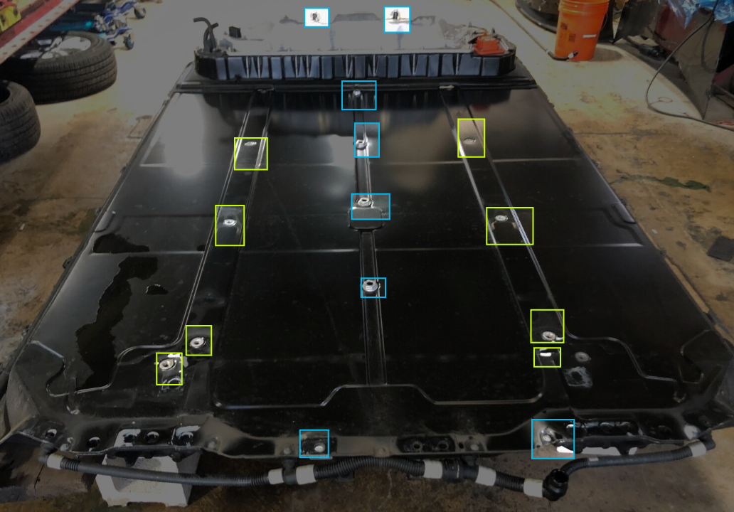
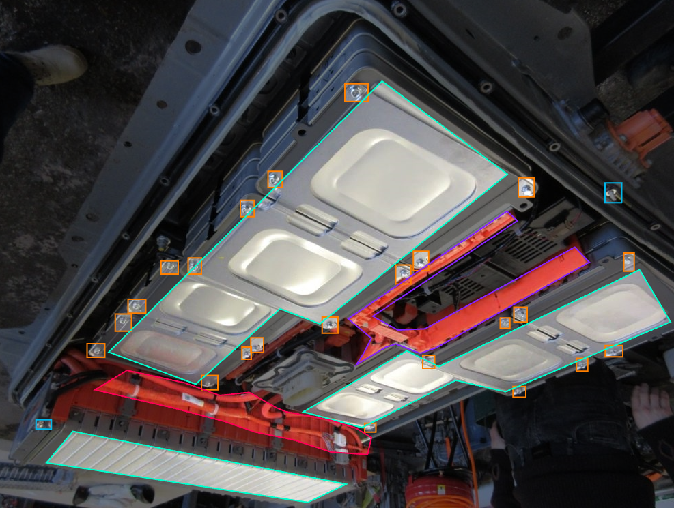
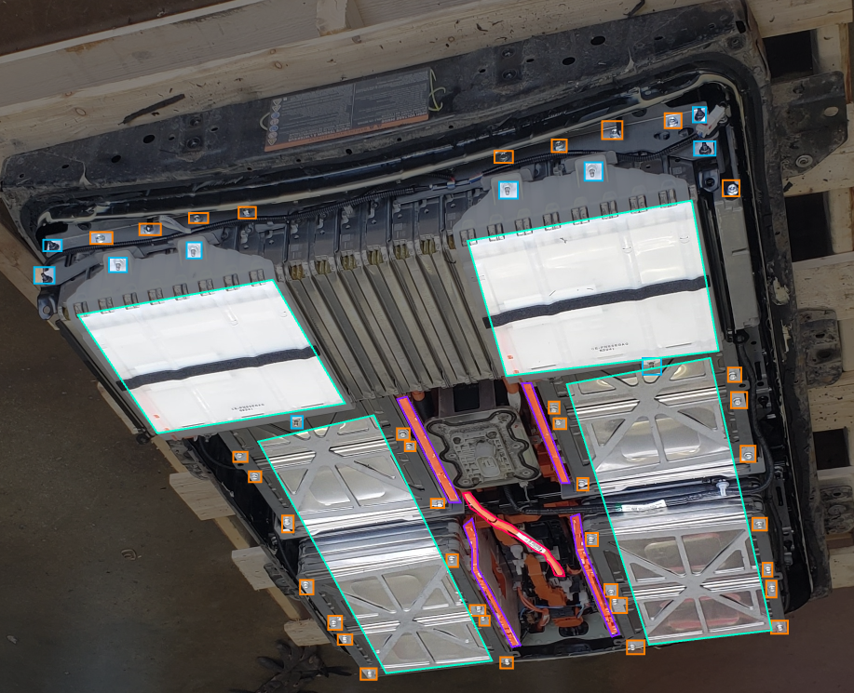
3.1 Coding Challenge: EV Battery pack
Classes
Frame
Battery Module
Screw
Cable
Bars
Augmentation:
Flip: Horizontal, Vertical
Shear: ±10° Horizontal, ±10° Vertical
Saturation: Between -25% and +25%
Brightness: Between -15% and +15%
Exposure: Between -10% and +10%
Blur: Up to 2.5px
Split: 345 Images
Training: 87%, Validation: 10% and Testing: 3%
Reference:
url ={ https://universe.roboflow.com/mtech-project-ohj8a/ev-battery-pack }, journal = { Roboflow Universe }, publisher = { Roboflow }, year = { 2024 }, month = { mar }, note = { visited on 2024-03-13 },

Slide 12
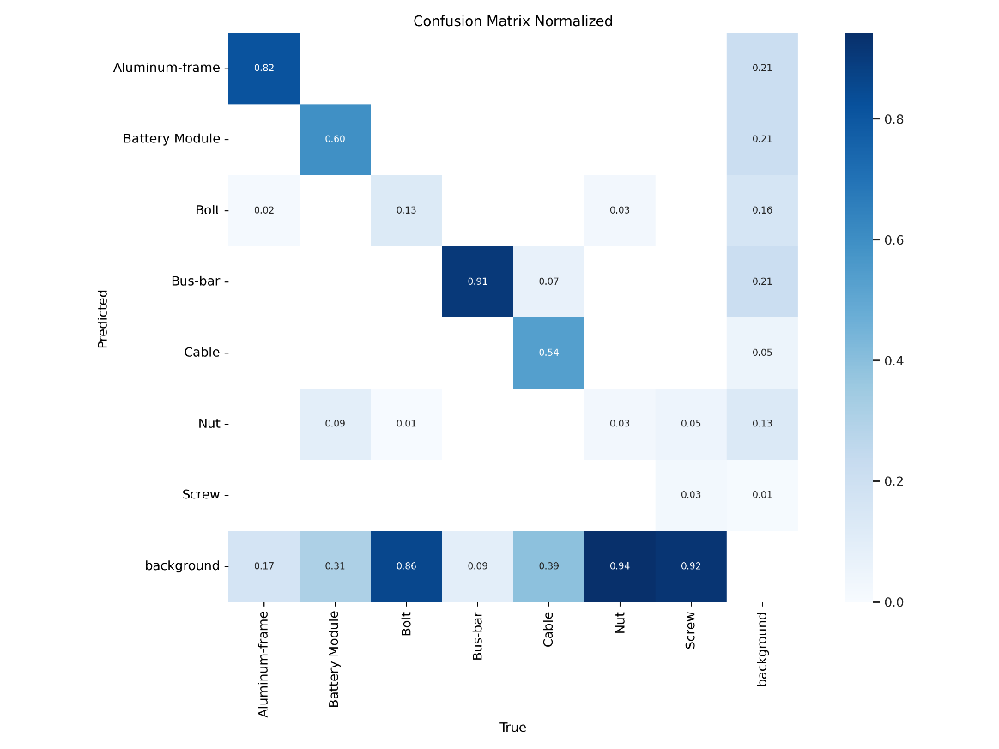
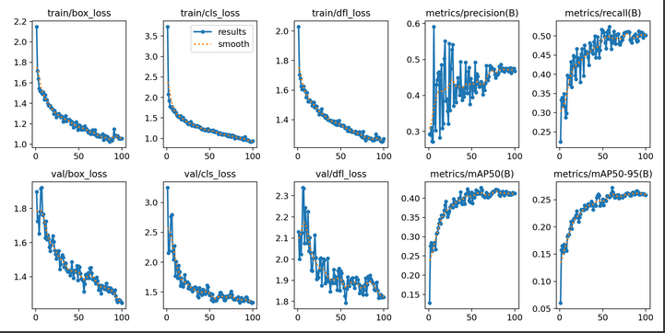
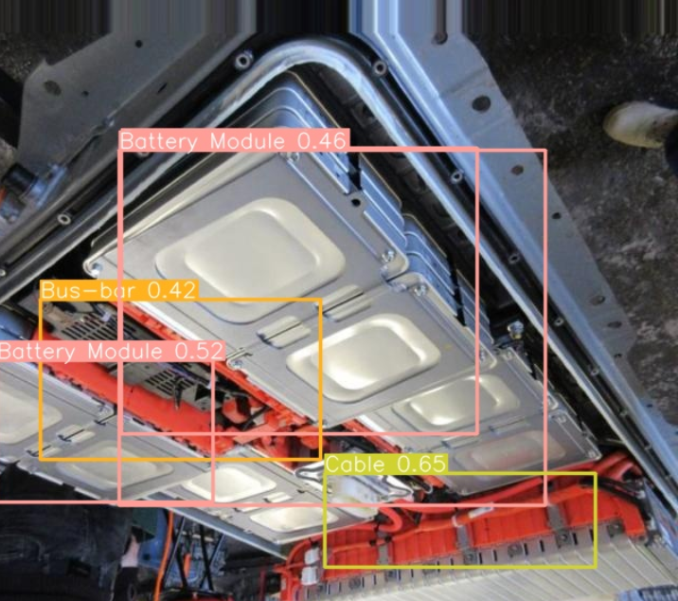
3.2 Yolov8: Trianing & Testing

Slide 13
4. Conclusion
DL based object detection: YOLO v8
Faster
Lighter
Generative AI and Synthetic Data:
Explore GANs and VAEs
EV Battery pack dataset:
Annotate
Augmentation
Train & test yolov8:

Slide 14
Thank you !!
Please don’t hesitate to send an email for questions.
Contact email: abdulrehman786302@gmail.com

